Slide 1


A STUDY ON THE IMPACT OF ORAL GLUCOSE LOAD ON TOTAL AND SEGMENTAL PHASE ANGLE IN HEALTHY NORMAL INDIVIDUALS USING A NON-INVASIVE WEARABLE BIOIMPEDANCE ANALYSER
PROJECT-BASED INTERNSHIP REPORT
Presented By
Abu Saleh Khan (20BSM002)
Department of Electronics and Communication Engineering
Under the supervision of
Dr. Koushik Dutta
Dr. Deva Priyakumar U
Assistant professor, ECE, PDPM IIITDM Jabalpur
Professor, CCNSB, IIIT Hyderabad

Slide 2
Outline
Introduction
Objectives
Results and discussions
Conclusions
Future works
References
1

Slide 3
Introduction
I-Hub-Data is a Technology Innovation Hub (TIH) established by IIIT Hyderabad as part of the National Mission on Interdisciplinary Cyber-Physical Systems (NM-ICPS) scheme of Department of Science and Technology, Govt of India. It is dedicated to enhancing national research and deploying solutions in Data Banks, Data Services and Data Analytics. The Hub aims at putting together largescale datasets as well as developing solutions based on such datasets through Applied Research.
I basically assign to Participate in current Embedded/IoT system engineering research in medical IOT applications.
Design, development, production, testing, and maintenance of Embedded systems, sensors, and PCB.
Perform Embedded software interfacing, testing, and software release updates.
4

Slide 4
Objectives
The bioelectrical impedance analysis, or bioimpedance analysis (BIA), which is used to diagnose and monitor pathologies of the human body, was developed in the early 1960 s, and it has been recognized as a safe, rapid, reliable, easy, and cost-effective technique.
BIA is a measurement technique based on the electrophysiological characteristics of the dielectric and conductive properties of human tissues. BIA has been widely used to measure body composition. Recently, many studies have reported the possibility of using BIA to measure health status indicators and/or clinical outcomes in clinical populations using raw bioimpedance parameters, such as reactance, resistance, and phase angle (PA).
In particular, PA has been extensively investigated as an important index for monitoring and screening various diseases and conditions, such as mortality, nutrition status, diabetes, hemodialysis, chronic heart failure, and liver cirrhosis, etc.
4

Slide 5
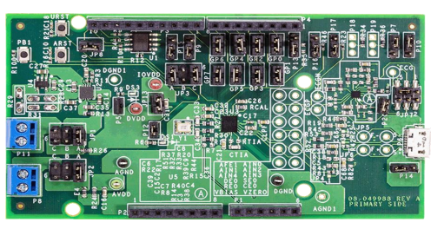
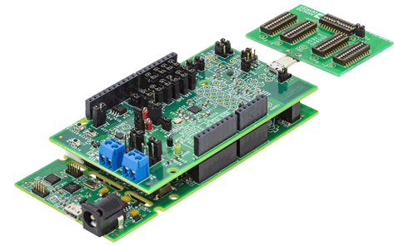
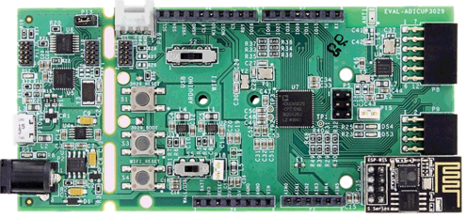
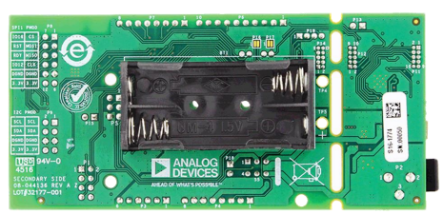

Devices
4

Slide 6
Novel Contribution-1
As a young research fellow, I have been assigned an ongoing project that are with collaboration of IIIT H and Apollo hospital.
We are making Wearable device a belt that are put on chest and in which four electrode are uses to measure bioimpedance of Person body and We use MUX to measure BIA at By change position of Voltage difference.
First I was assign to debug the code that give some Error on measuring direct Bio impedance by using Four electrode.
Second task was to make custom PCB by use of only AD5940 Analog front End for direct Measurement of Bio impedance by using only 4 electrode. So that we make size of device small and compact.
For Custom PCB Device I make schematic of AD5940 and then I make Bill of material(BOM) File and then order Components of Custom PCB device.
Do placement and routing of SMD component on PCB Board. After completing Custom PCB device.
Next task was to calibrate the custom PCB device so for that purpose I have to review total 11 paper related to Bioimpedance and AD5940 in which I have to find calibration they have done.
4

Slide 7
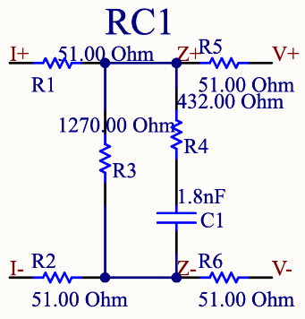
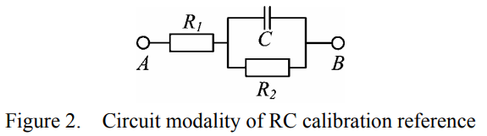
Novel Contribution-2
I have found many devices that are commercially uses for bio impedance measurement that are some expensive.
Then I found a unique method and it is cheap and the method is Three-References Self-Calibration method is used for calibration and validation purposes after reviewing those papers.
We use the three-element RC circuits reference impedances for calibration The reference circuit consists of a series/parallel association of two resistors and a capacitor.
Now I am going to make PCB of RC circuits and after that I measure the Bioimpedance by connecting AD5940 with 4 electrode to four I+,I-,V- and V+ of RC circuit.
4

Slide 8


Novel Contribution-3
Three-References Self-Calibration method:-
true values (Zr0, Zr1, Zr2)
original measured values (Zmr0, Zmr1, Zmr2)
Before calibration, the true values (Zr0, Zr1, Zr2) can be obtained by a precise impedance analyzer
The complex impedance between terminals A and B can be calculated using
where XC is the impedance of the capacitor C and
4

Slide 9
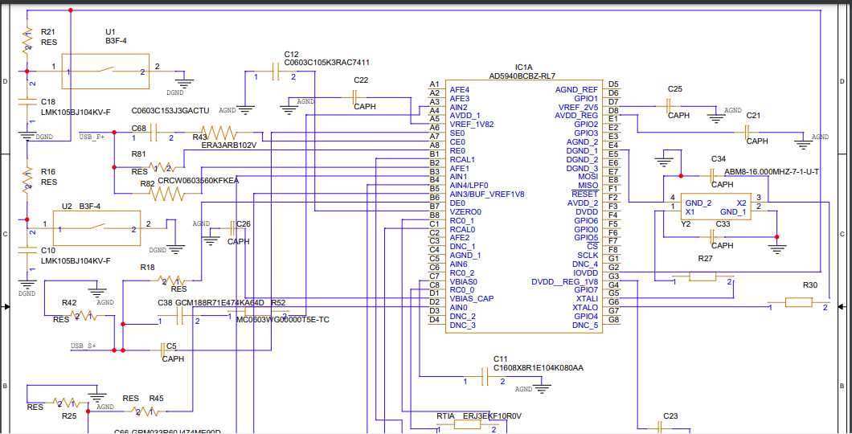
Results and Schematic
8

Slide 10
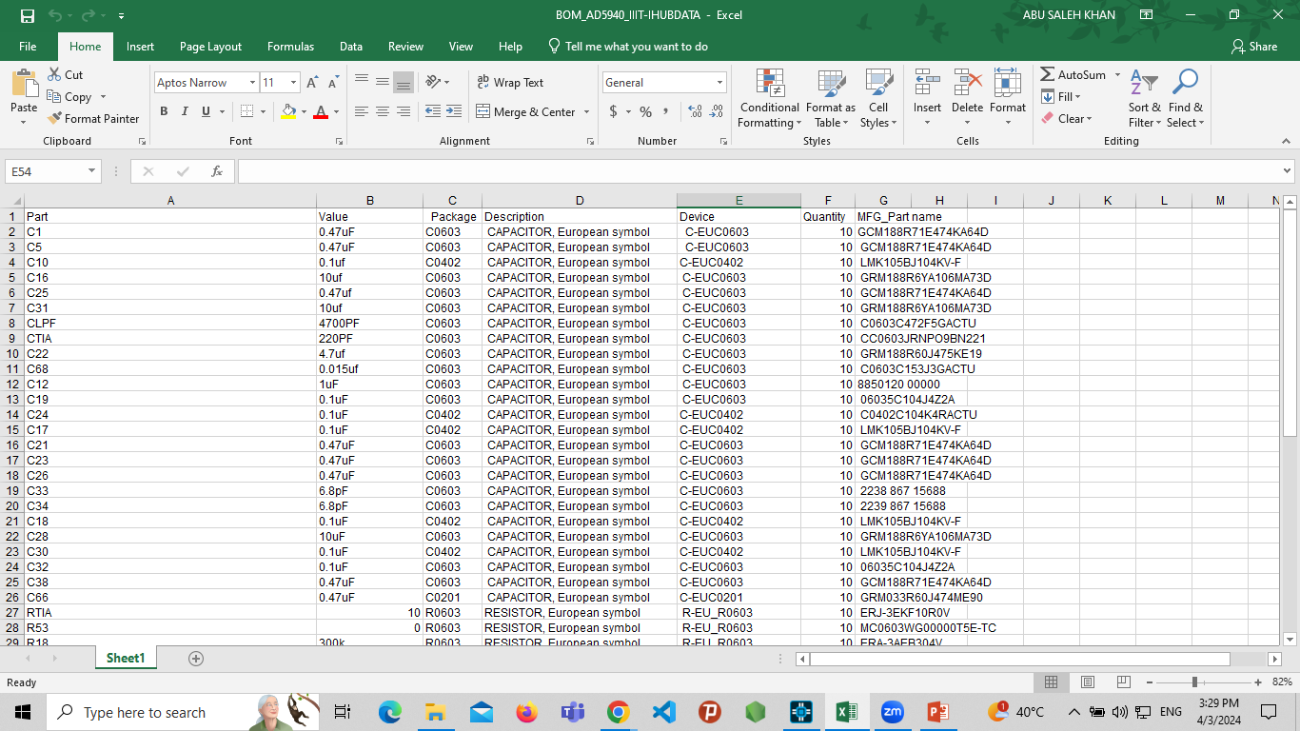
Results and BOM File
8

Slide 11
Methodology-1
The AD5940 is a device that is specifically designed for bio electrochemical impedance spectroscopy (BEIS) and electrochemical applications. It is known for its low power consumption, making it a suitable choice for portable and battery-powered devices.
Basically I have done Debugging in Keil Software that are uses for embedded system on the code AD5940 and ADCuP3029 microcontroller for proper Spi communication.
And for Schematic of Custom PCB Device I have used OrCAD Capture CIS software Provided by cadence for Schematic of PCB device.
I converted the schematic into PCB layout and after that we do placement and routing and generate Gerber file.
After that I make Bill of Materials (BOM) file in excel by using datasheet of AD5940 and I also learn how to read datasheet of other components during this internship.
4

Slide 12
Methodology-2
After that I make Bill of Materials (BOM) file in excel by using datasheet of AD5940 and I also learn how to read datasheet of other components during this internship.
And After I place order of Gerber file of PCB Board and after some day I get Gerber file and components and the I mounted SMD component on PCB board.
After the completion of Custom PCB board for measuring bio-impedance of human body.
We have to calibrate the custom device measurement of BIA so for that purpose we use our custom PCB device for bio impedance measurement and to cross verify with commercial device because it is cheap and provide frequency range between 1Hz to 200 kHz because of AD5940.
I review 11 paper to find best calibration method and I found a Three-Reference Calibration Algorithm for A Bioimpedance Spectrometer.
4

Slide 13
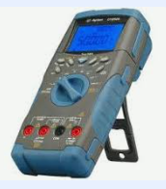
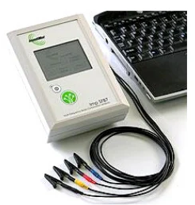
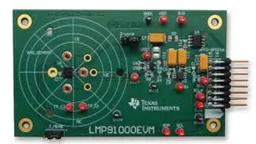
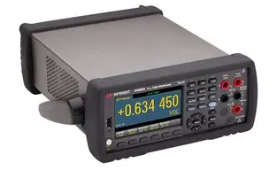
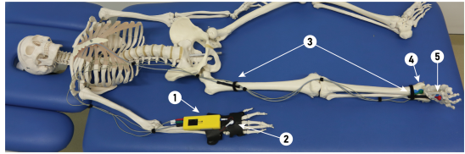
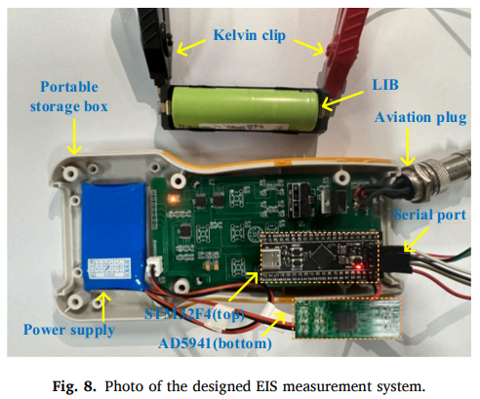
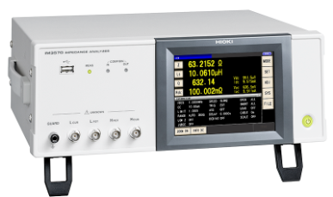
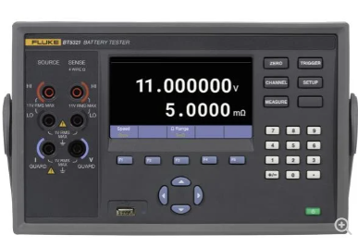
Results and Calibration Devices
Keysight 34460A- price- 110000
Agilent U1252A
Price- 16000
IC LMP91000 Price- 10,000 rupee
SFB7: A commercial device
BIACorpus
Hioki IM3570
Price- 6 Lakh
Fluke-BT5300
8

Slide 14
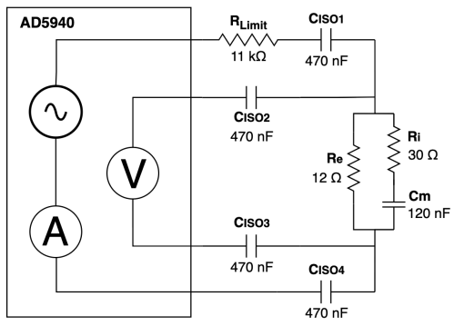
Results and Calibration Device
Figure 2. Circuit modality of RC calibration reference
Fig. 1. Block diagram of the AD5940 measuring board T1
8

Slide 15
Methodology-3
Now I will make 3RC circuit PCB and make algorithms for Data analysis of test board and Calibration.
All calibration (Ci) and test (Ti) boards will measured with each device. Then MATLAB will used to calculate the calibration factors for each frequency point from the C boards and to correct and plot the measurements of the T boards.
4

Slide 16
References-1
A Novel Wearable Device for Continuous Bioimpedance Monitoring in Congestive Heart Failure Patients.
Continuous monitoring of the health status of cement-based structures: electrical impedance measurements and remote monitoring solutions.
Design of a portable electrochemical impedance spectroscopy measurement system based on AD5941 for lithium-ion batteries.
Accuracy Improvement by A Three-Reference Calibration Algorithm for A Bioimpedance Spectrometer
Application of a three-reference calibration algorithm for an electrical impedance spectrometer
Designing a High Input-Impedance Buffer for Dry-Electrode Bioimpedance Analysis
Detection of the Yogurt Incubation Kinetics by Portable Impedance Converter
Enhancing the Precision of AD5940 Segmental Bioimpedance Measurements through Self-Calibration.
15

Slide 17
References-2
Low-cost impedance analyzer and IDC sensors: an imperfect tool for dielectric condition monitoring
Smart Cup: An impedance sensing based fluid intake monitoring system for beverages classification and freshness detection
Tiny Stat: A Miniaturized Potentiated for Portable Electrochemical Measurements
Towards Wearable Sweat Sensing for Glucose and Lactate: Sensors Characterization
Wearable bioimpedance for continuous and context-aware clinical monitoring.
https://www.analog.com/en/resources/evaluation-hardware-and-software/evaluation-boards-kits/ev-cog-ad3029.html#eb-overview
15

Slide 18
Thank You
16

